Slide 1
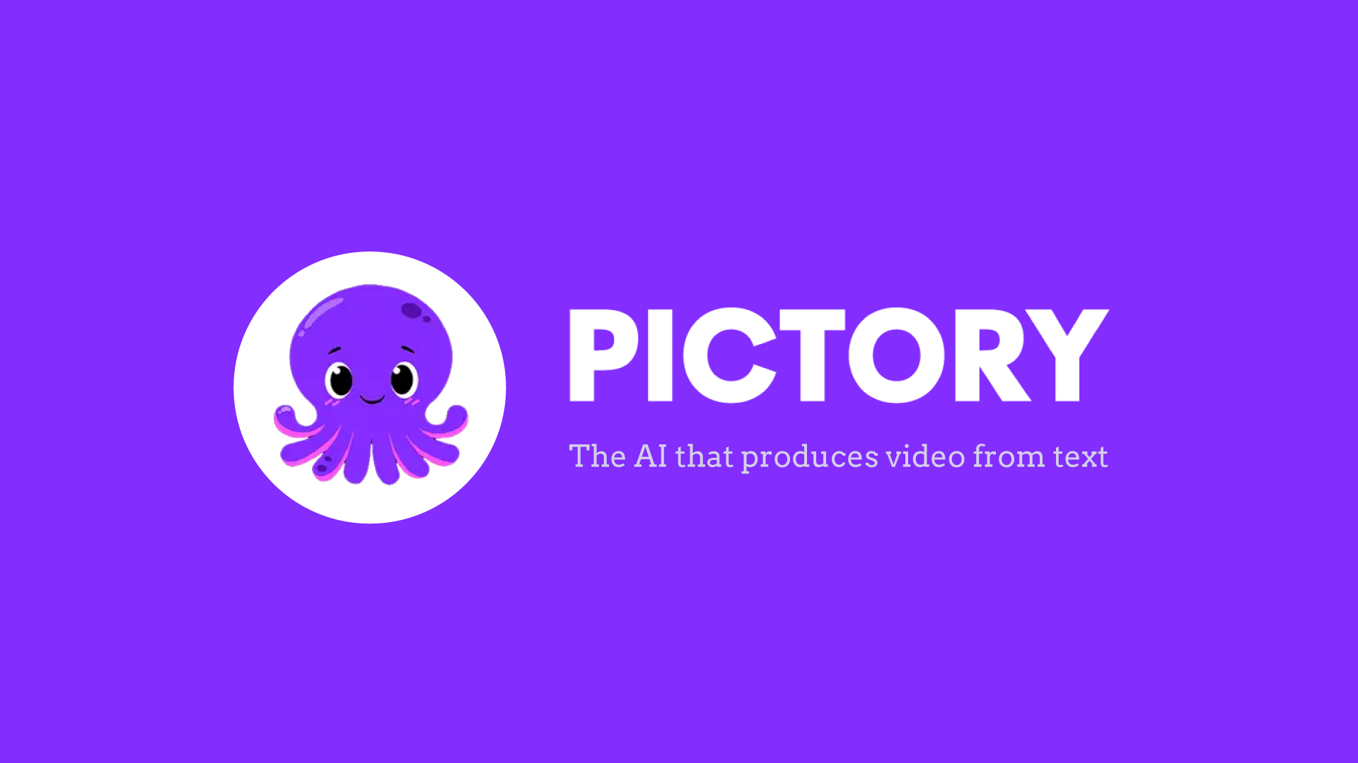

Slide 2
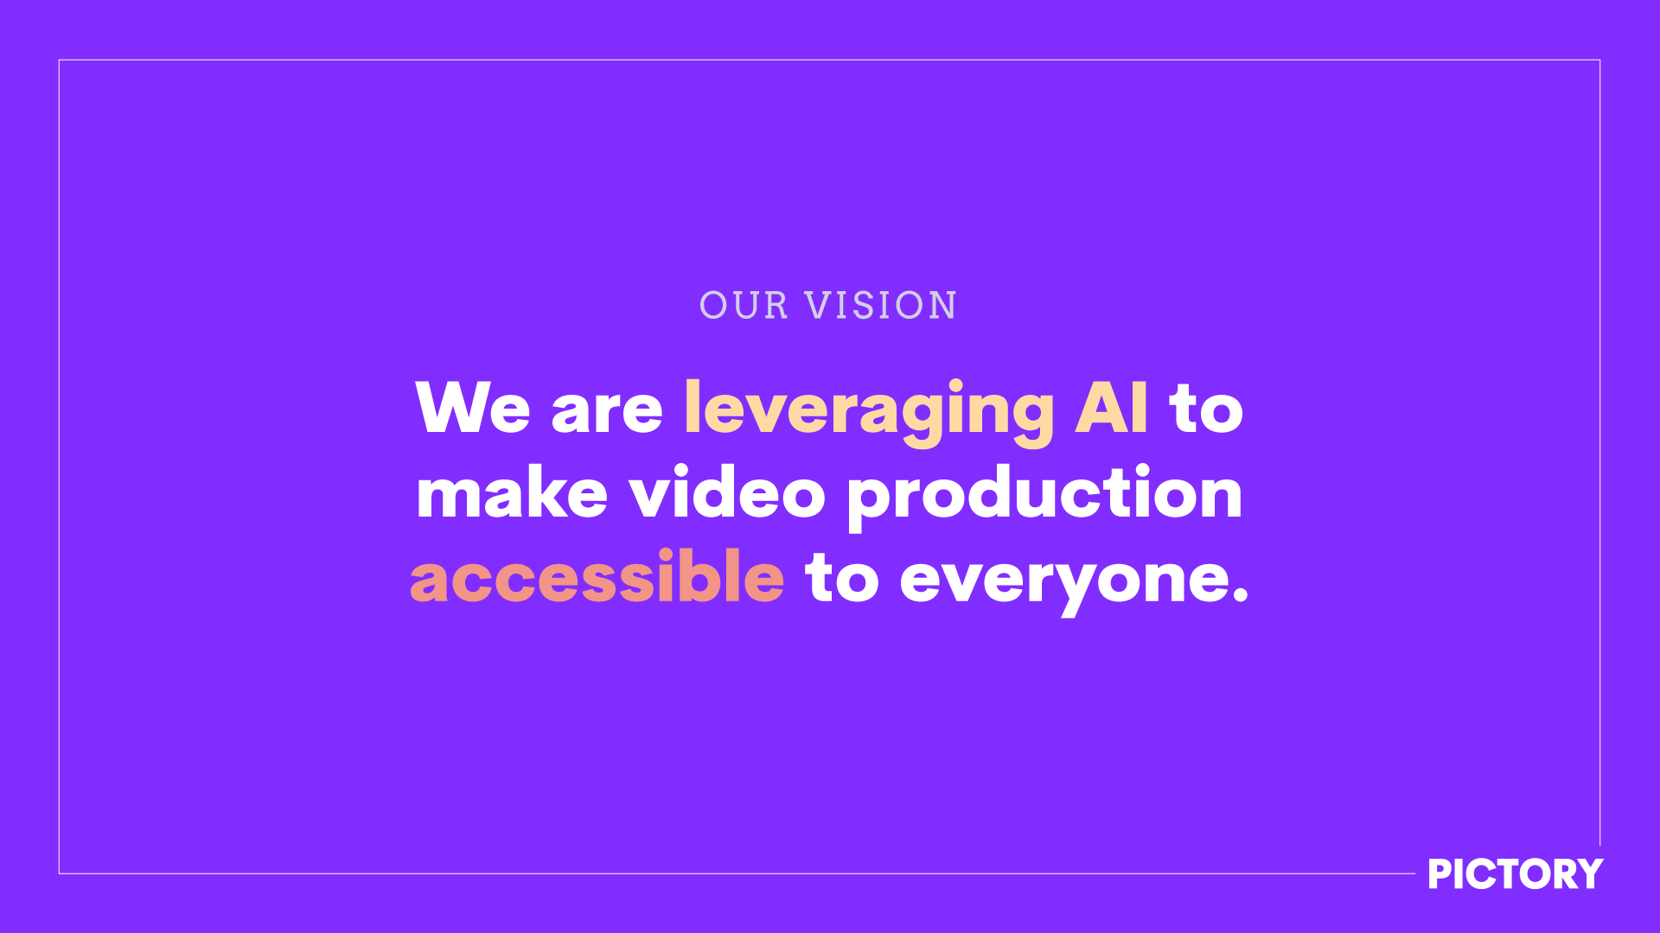
Where is marketing going in 2024
AI
Video

Slide 3
2nd
YouTube is the 2nd largest search engine
2x – 12x
Higher engagement with video posts on social media than text or image
85%
Percent of social videos watched on mute
5%
Average reach of an organic social post

Slide 4
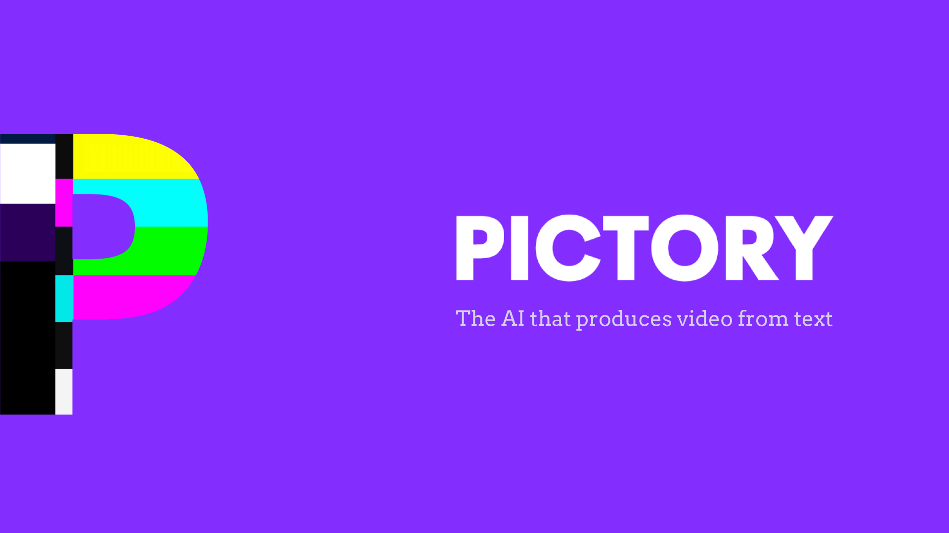
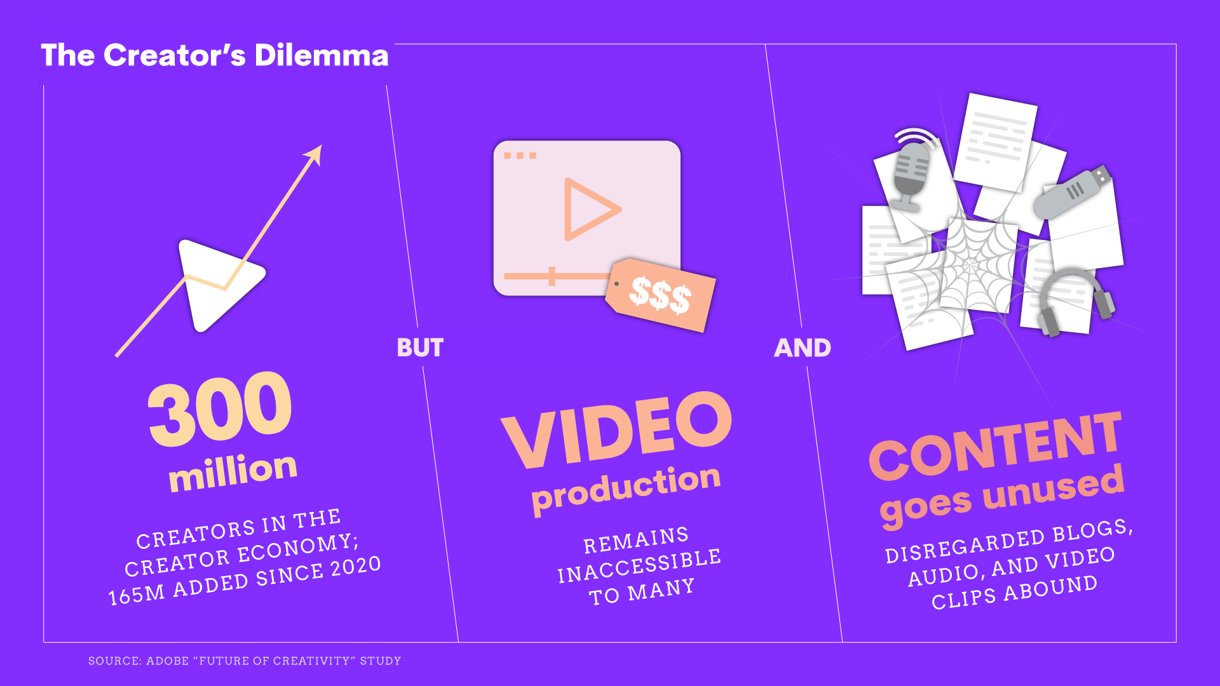

Slide 5
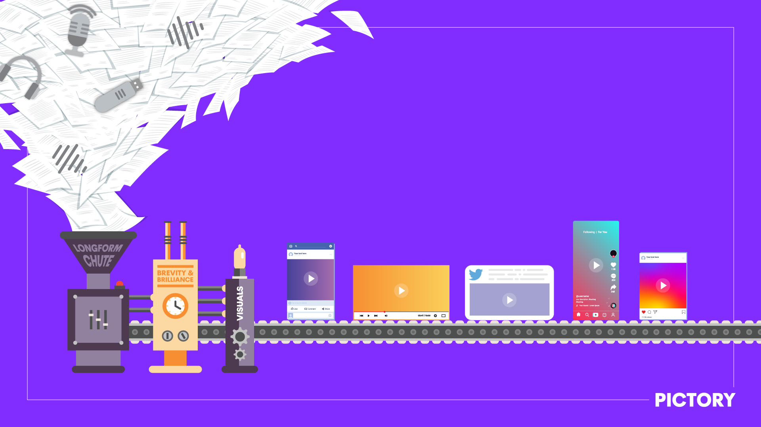
Leverage AI to repurpose existing content into high-frequency videos.

Slide 6
Practical Takeways
Start a YouTube Channel
Start repurposing content into videos
Blogs to videos
Stories/scripts to videos
Create highlight reels of recorded videos (webinars, training, demos, etc.)
Extract snippets from recorded videos or podcasts

Slide 7
Video lengths & sizes for different platforms
YouTube – 2 min to 20 min (average ~10 min) – horizontal
YouTube Shorts – under 1 min – vertical
TikTok – under 1 min – vertical
Instagram Reels – 15 to 60 sec – vertical or square
Facebook – under 1 min – horizontal or square or vertical
Twitter – under 2 min – horizontal or square
LinkedIn – under 1 min – horizontal or square

Slide 8
Some useful tools
ChatGPT – summarization, extract quotes & stats
Getty, Shutterstock, Google Images for accompanying visuals
Canva – easily create or edit visuals
Pictory – text to video
Rev.com, Pictory – transcribe video, caption video
Movie Maker, iMovie, Pictory – easy video editing
Hootsuite, Buffer – schedule social posts

Slide 9
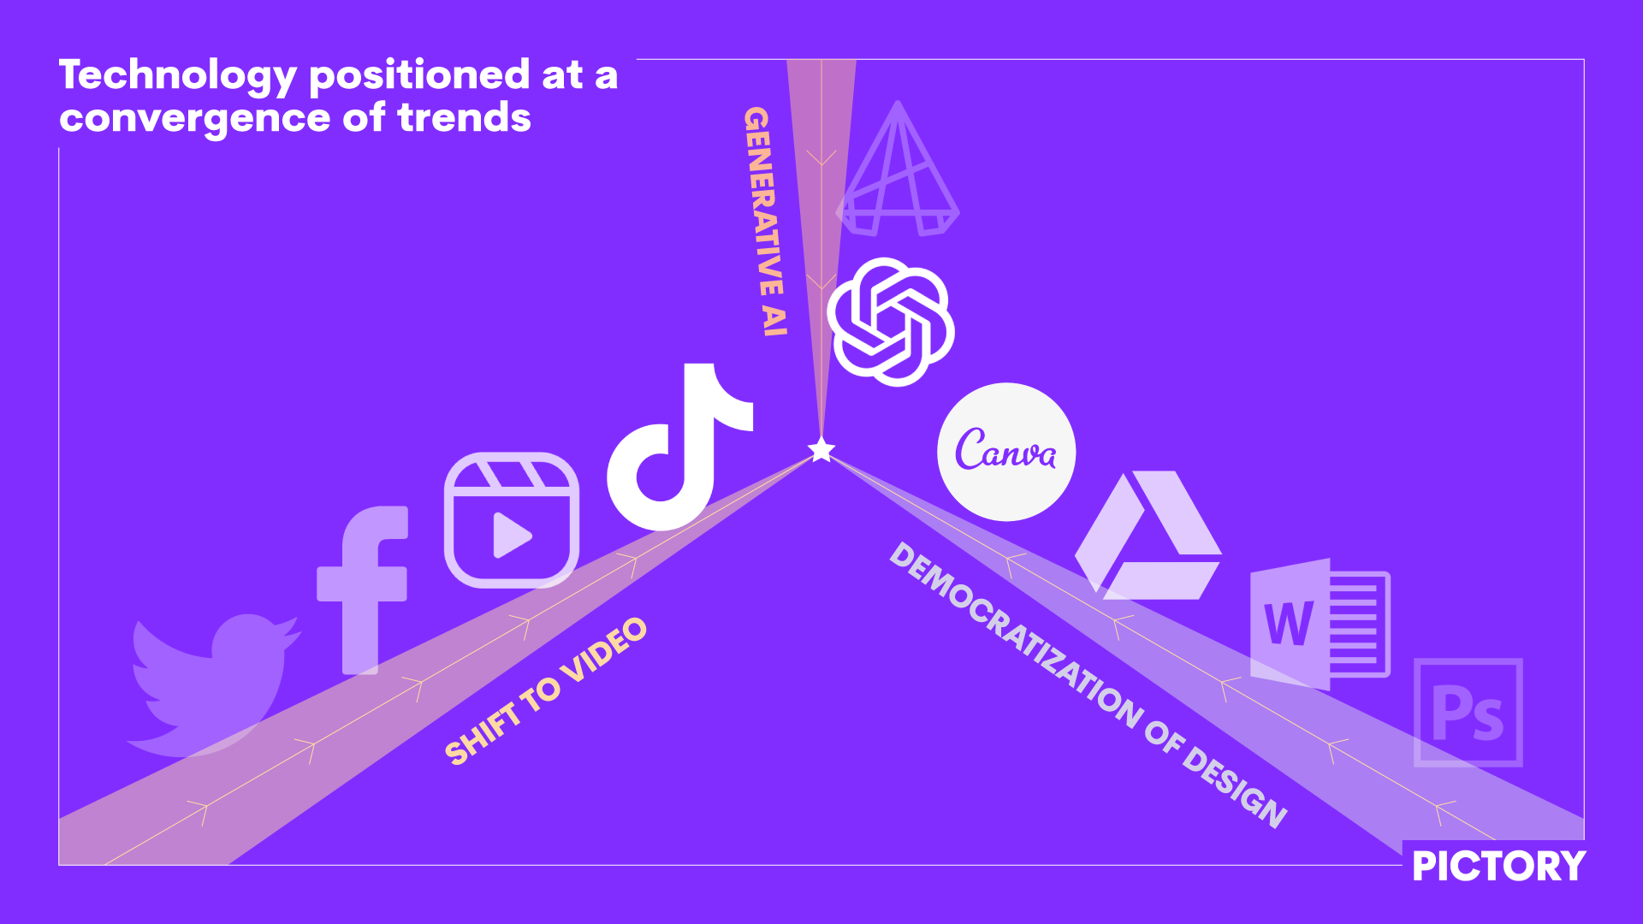

Slide 10
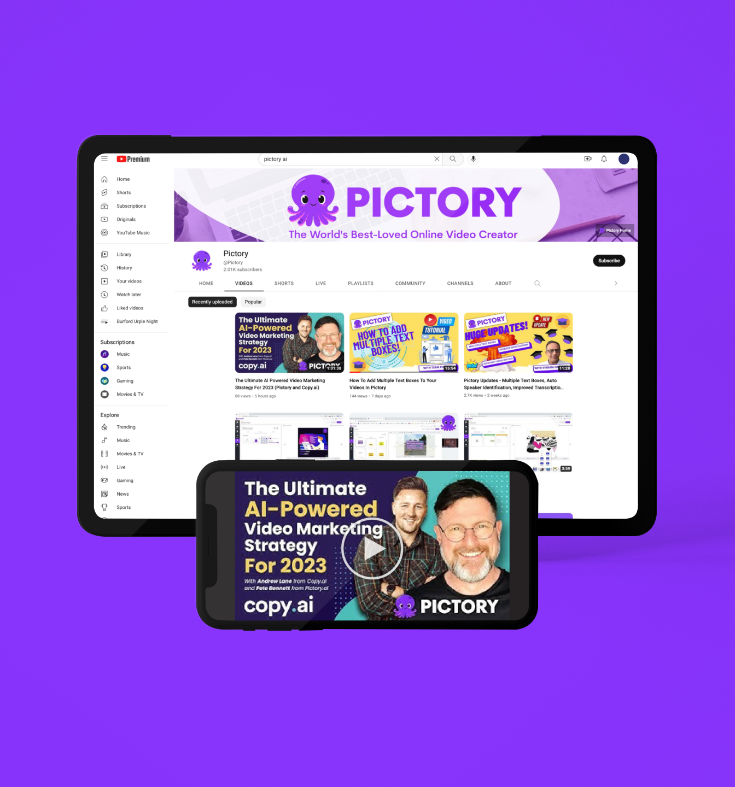
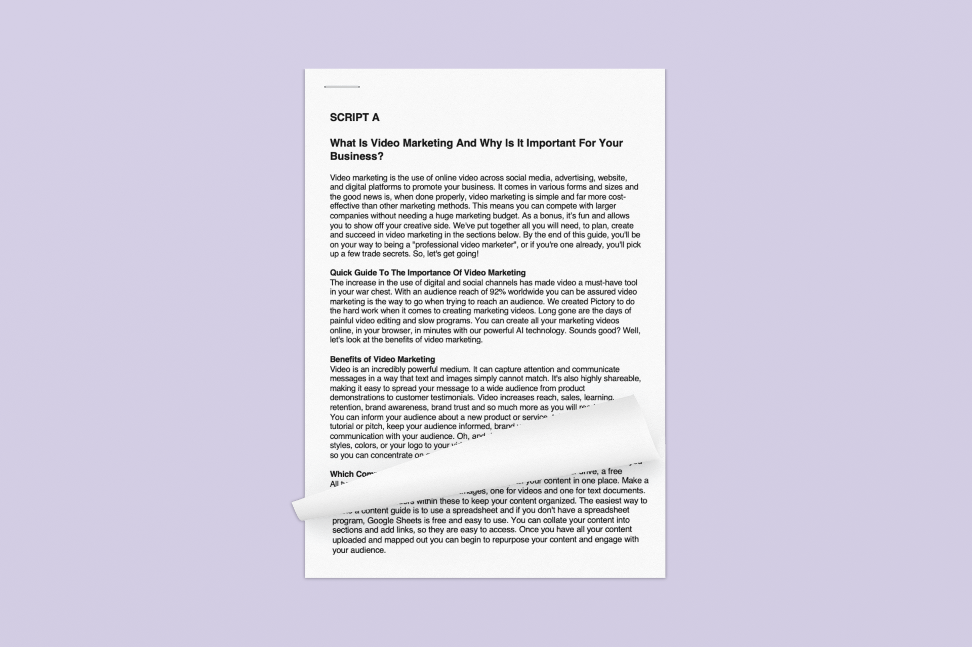
SCRIPT
VIDEO
AI Powered Visual & Music Selection

Slide 11
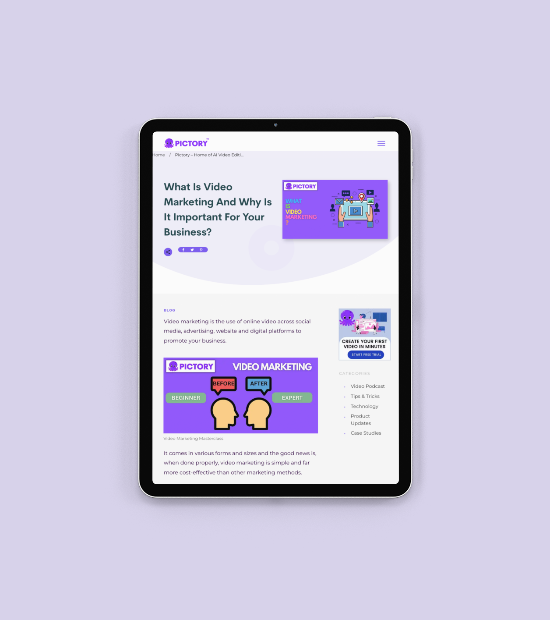
BLOG
VIDEO
AI-Powered Text Summarization & Video Production

Slide 12
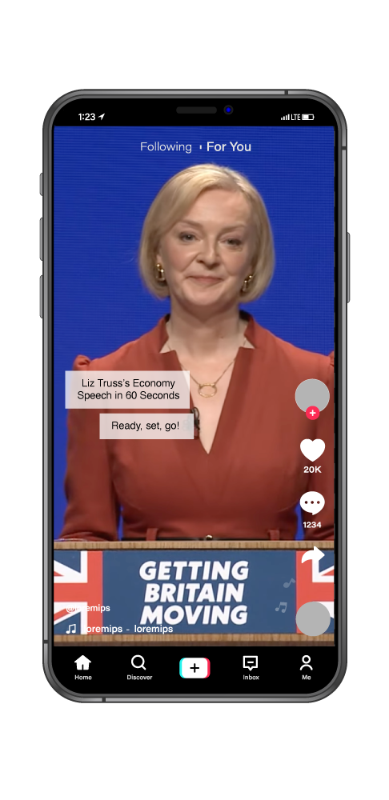
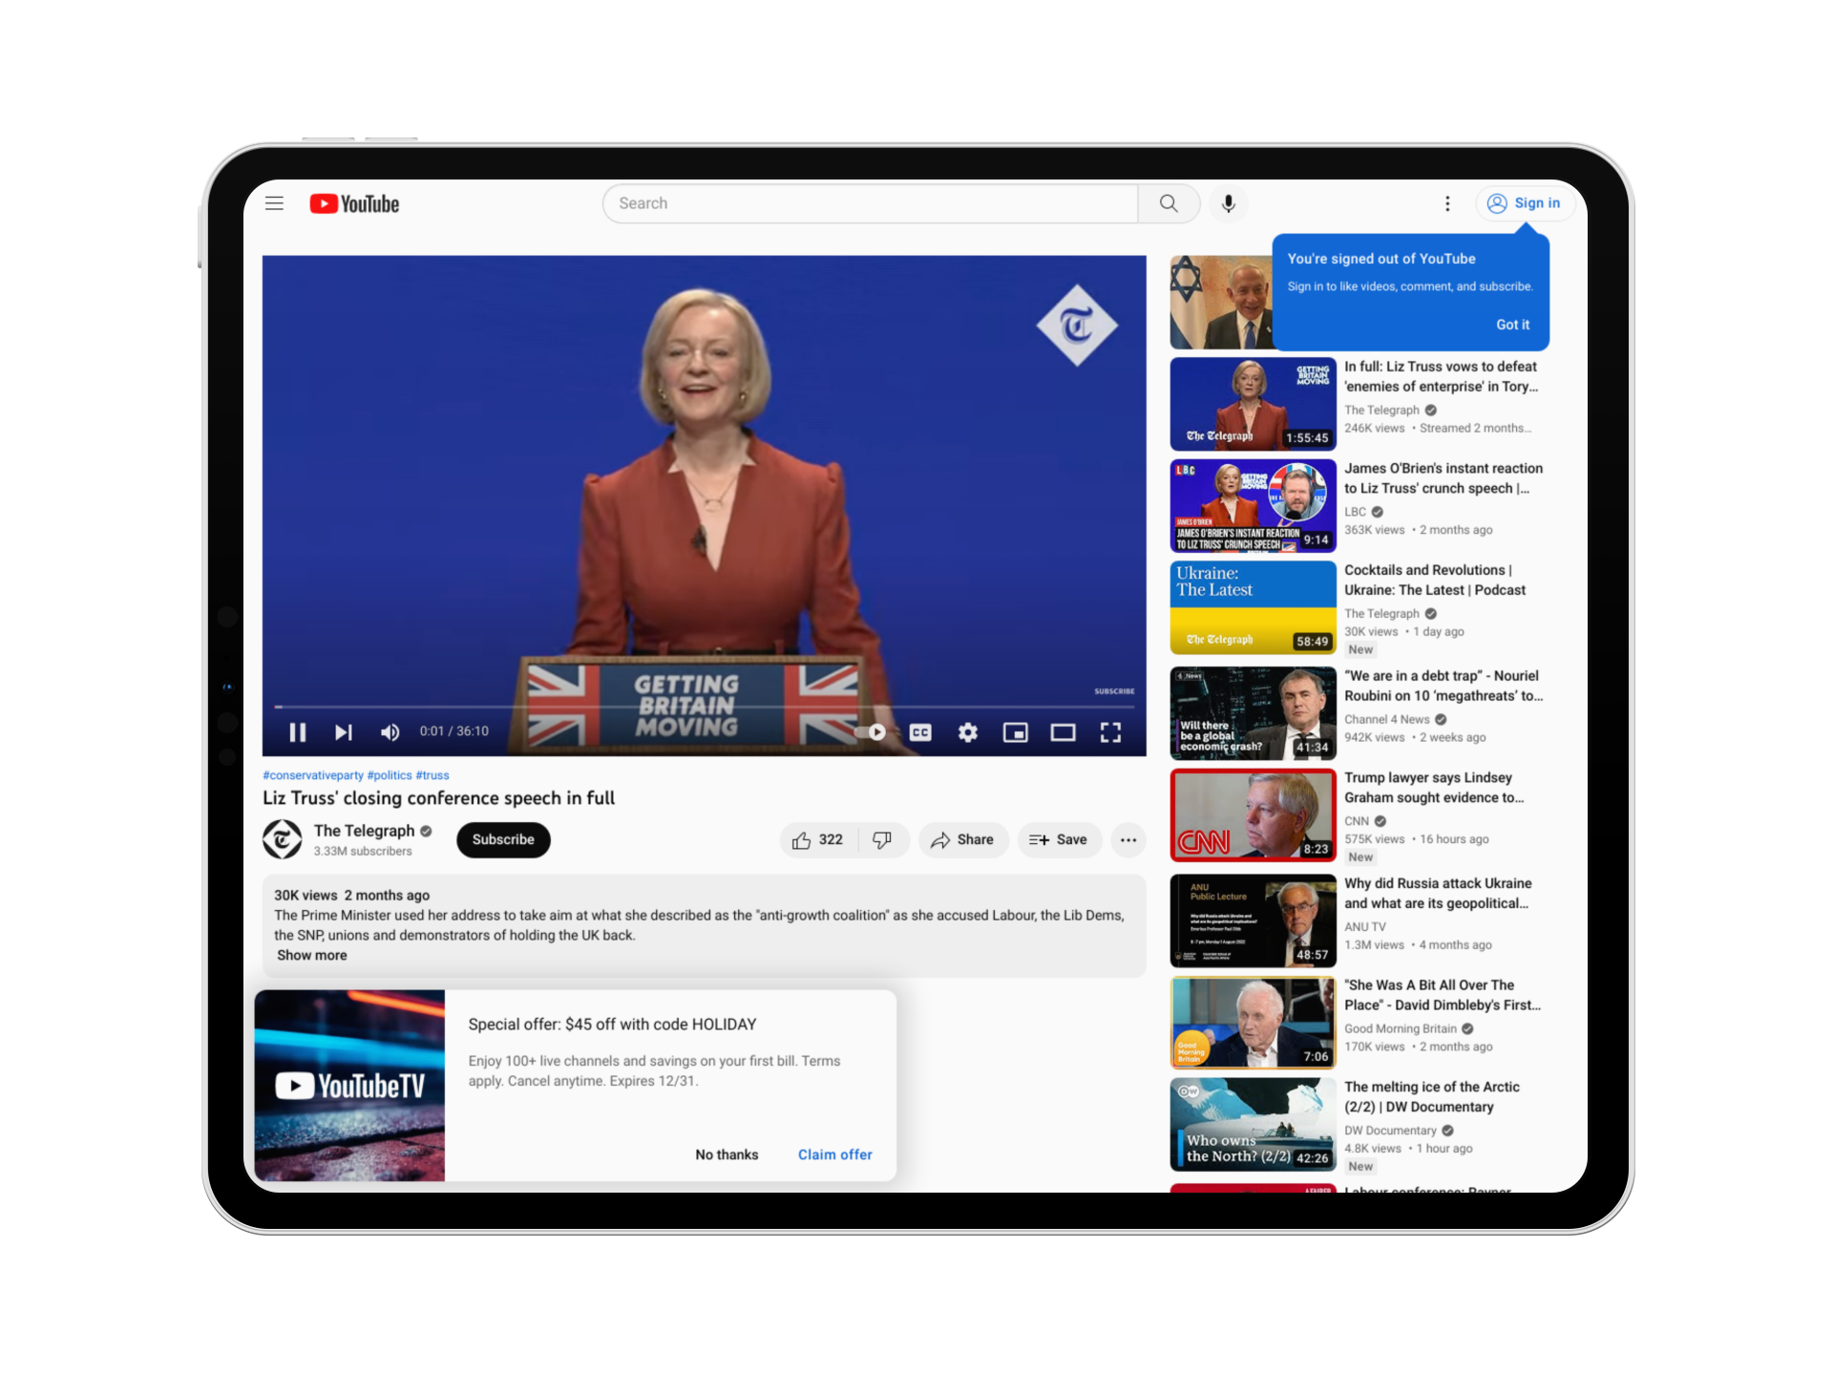
LONG-FORM VIDEO
HIGHLIGHT REEL
AI-Powered Video Editing & Summarization

Slide 13
Video lengths & sizes for different platforms
YouTube – 2 min to 20 min (average ~10 min) – horizontal
YouTube Shorts – under 1 min – vertical
TikTok – under 1 min – vertical
Instagram Reels – 15 to 60 sec – vertical or square
Facebook – under 1 min – horizontal or square or vertical
Twitter – under 2 min – horizontal or square
LinkedIn – under 1 min – horizontal or square

Slide 14
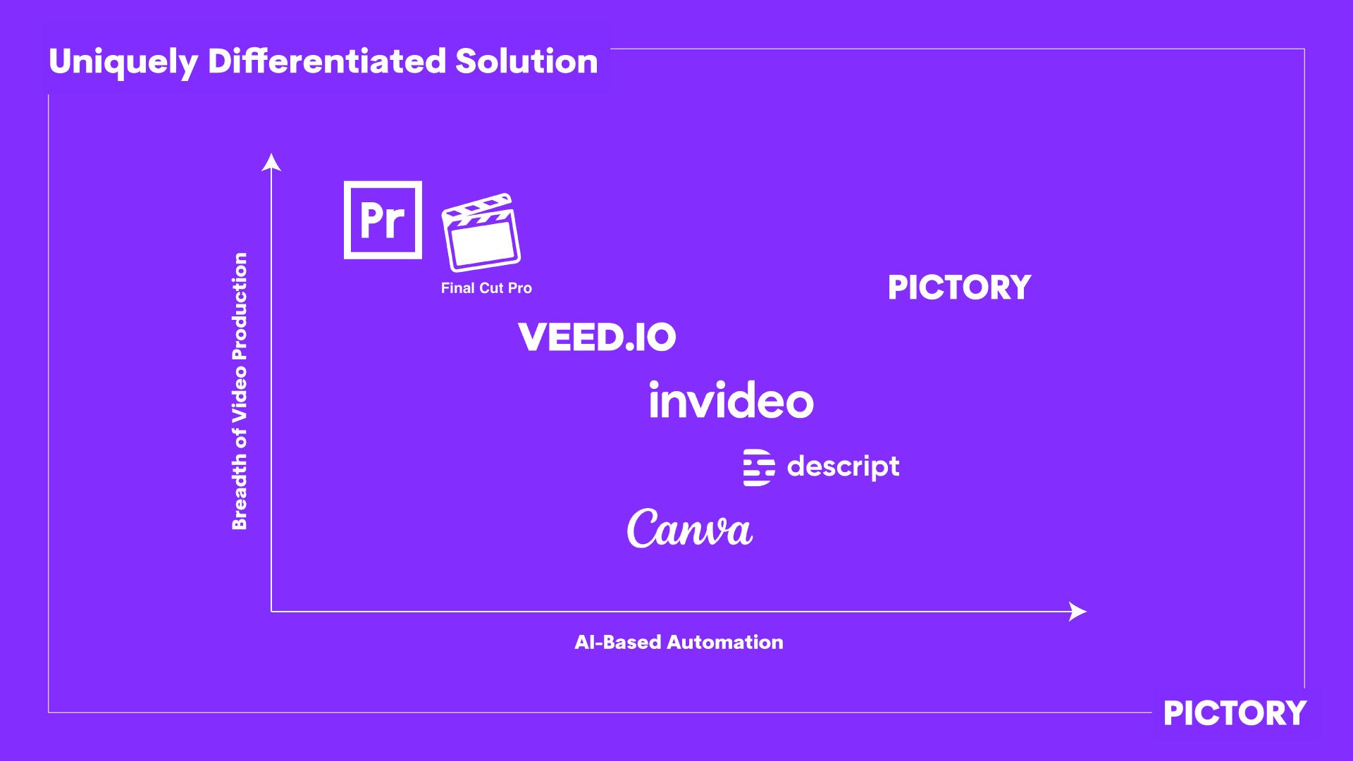
Key Differentiators:
Video Create & Video Edit in One Place
AI-Based Video Summarization*
Automated long-videos to shorts
Auto Voiceover Synchronization
*Patent Pending

Slide 15
DEMO

